Slide 1
Digital Signatures Video Lectures Available at https://drive.google.com/drive/folders/1vs9oXRkoNj5XMtsOvKqi_547xvrfxQzl

Slide 2
Review of Cryptography so far
Cryptography
Symmetric’
Asymmetric
Applications / Protocols
DES
3DES
AES
RSA
Discrete Log
Eliptive Curve
Digital Signatures
MAC
Others

Slide 3
Notes
We are NOT creating something NEW
We will use what we have learnt so far and try to build some new stuff.

Slide 4
AGENDA
Introduction to Digital Signatures.
Security Services.
RSA Digital Signatures
How to built a signature
An attack on RSA Digital Signature

Slide 5
Introduction to Digital Signatures
GOAL: Signature like function for the electronic world
What happen when you sign in real world vs sign in digital world?

Slide 6
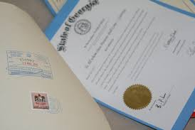
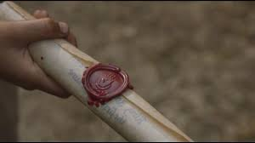
Conventional Signatures
Degree
King’s Message
We sign every degree.
It is a proof of authenticity of the sender / issuer.
Problem:
We can create a fake signature.

Slide 7

Signatures for Digital Products
Pdf files
Audio Tapes
DVDs
00100101001010100101010101001100001010101001101010
$${Sig}_{k}\left(x\right)=s$$
10101001010110101010
Every time I send a document; email or any other thing, I will put my unique long bit pattern under it to sign it.
It is the most stupid thing as you can always make a perfect copy of it

Slide 8


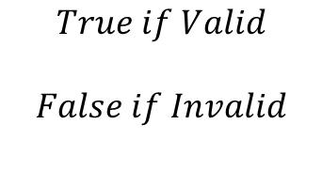

Introduction to Digital Signatures
But we know cryptographic algorithms.
We will use these algorithms to generate our Digital signatures.
. x
$$\left(x, s\right)$$
$$True if Valid$$
$$False if Invalid$$
$${s= Sig}_{k}\left(x\right)$$
$Verification Fuction\left(x, s\right)$ =
. s

Slide 9




Digital Signatures with Symmetric Cryptography
Alice Bob
$if x^{′}=x,Verified$
$$if x^{′} !=x,Not Verified$$
$$Message=x$$
$${s= Sig}_{k}\left(x\right)$$
$$\left(x, s\right)$$
$$Verify \left(x,s\right)$$
$$x^{′}={Sig}_{k}^{−1}\left(s\right)$$

Slide 10
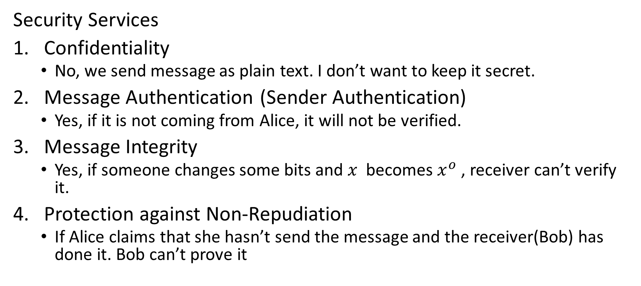
Digital Signatures with Symmetric Cryptography
Security Services
Confidentiality
No, we send message as plain text. I don’t want to keep it secret.
Message Authentication (Sender Authentication)
Yes, if it is not coming from Alice, it will not be verified.
Message Integrity
Yes, if someone changes some bits and $x$ becomes $x^{o}$ , receiver can’t verify it.
Protection against Non-Repudiation
If Alice claims that she hasn’t send the message and the receiver(Bob) has done it. Bob can’t prove it

Slide 11




Digital Signatures with Asymmetric Cryptography
Alice
$$K_{pr(A)}, K_{pub(A)}$$
$${s= Sig}_{Kpr\left(A\right)}(x)$$
Bob
$${Verify}_{Kpub(A)}(x,s)$$
$$x^{′}{= Sig}_{Kpub\left(A\right)}^{−1}(s)$$
$$if x^{′}= = x, true/false$$
$$K_{pub(A)}$$
$$(x,s)$$

Slide 12
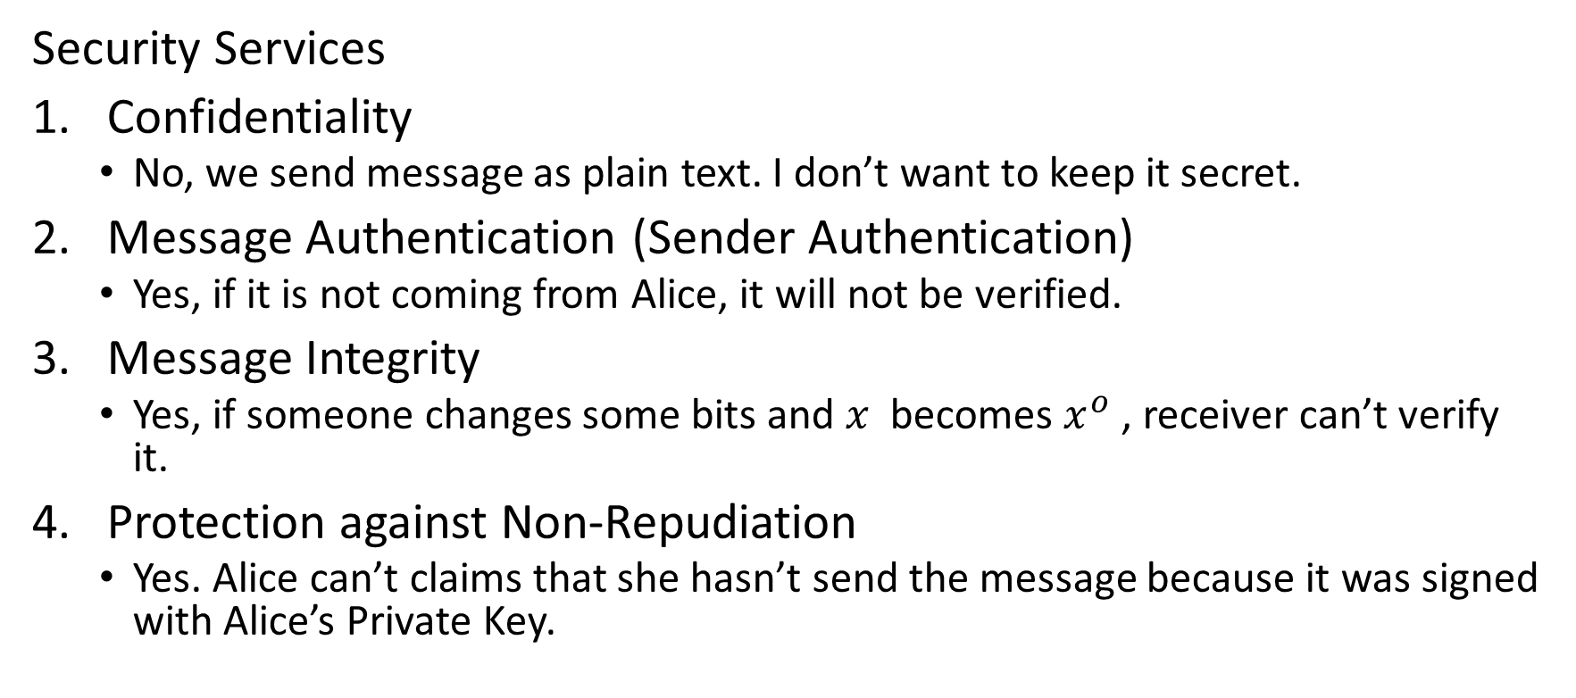
Digital Signatures with Asymmetric Cryptography
Security Services
Confidentiality
No, we send message as plain text. I don’t want to keep it secret.
Message Authentication (Sender Authentication)
Yes, if it is not coming from Alice, it will not be verified.
Message Integrity
Yes, if someone changes some bits and $x$ becomes $x^{o}$ , receiver can’t verify it.
Protection against Non-Repudiation
Yes. Alice can’t claims that she hasn’t send the message because it was signed with Alice’s Private Key.

Slide 13




Digital Signatures with Asymmetric Cryptography
Alice
$$K_{pr(A)}=(d)$$
$$K_{pub\left(A\right)}=(n,e)$$
$${s= Sig}_{Kpr\left(A\right)}(x)$$
= $x^{d} mod n$
Bob
$${Verify}_{Kpub(A)}(x,s)$$
$$x^{′}{=s}^{e}mod n$$
$$if x^{′}= = x, true/false$$
$$(n,e)$$
$$(x,s)$$

Slide 14
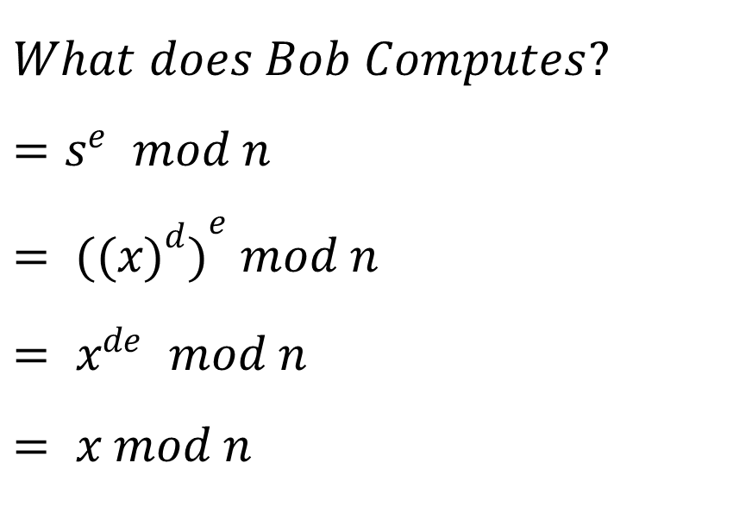
Proof of Correctness
$$What does Bob Computes?$$
$${=s}^{e} mod n$$
$$= {{((x)}^{d})}^{e} mod n$$
$${= x}^{de} mod n$$
$$= x mod n$$
$$if there is an attacker who has flipped the bits, it will not be verified$$

Slide 15





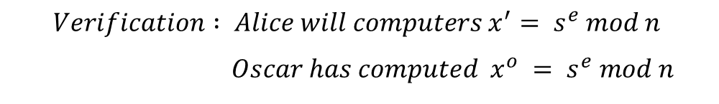
Forgery Attack on RSA Digital Signature
Oscar
Alice
Bob
$$K_{pr(B)}=(d)$$
$$K_{pub\left(B\right)}=(n,e)$$
$$s= x^{d} mod n$$
$$(n,e)$$
$$(x,s)$$
$Alice is a Bank and Oscar generates a message with valid signature.$For example
$$Oscar generates a fake message "transfer \$1000 from Bob′s account to Oscar′s Account$$
${Oscar knows what Alice will compute;its}^{′}{ "s}^{e}mod n“, he will do two things$
$Choose s Є x_{n}\left(n is 2048 bits number\right)$
$${2) Computes x^{o}=s}^{e} mod n$$
$$Verification : Alice will computers x^{′}= s^{e} mod n$$
$$Oscar has computed x^{o} = s^{e} mod n$$

Slide 16
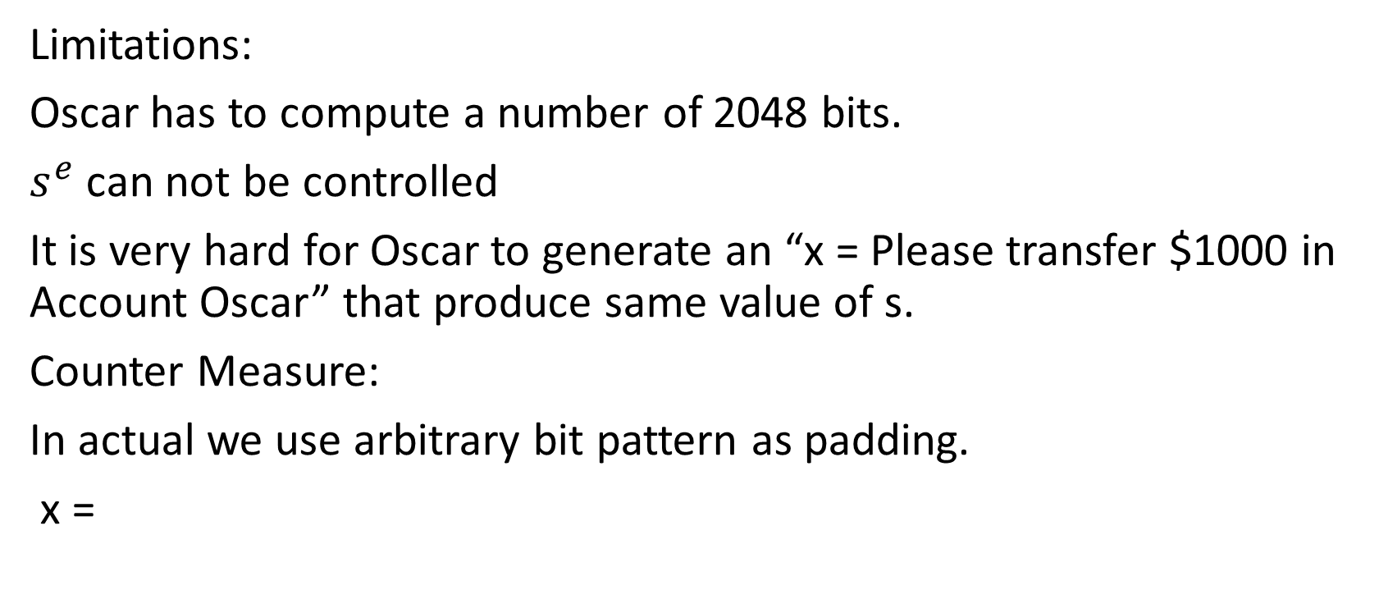
Forgery Attack on RSA Digital Signature
Limitations:
Oscar has to compute a number of 2048 bits.
$s^{e}$ can not be controlled
It is very hard for Oscar to generate an “x = Please transfer $1000 in Account Oscar” that produce same value of s.
Counter Measure:
In actual we use arbitrary bit pattern as padding.
x =
message
padding

